Slide 1




COVID-19 Data Analytics & Visualization using Power BI
CU_CP_Team_4053
Kunjan Nandha
Debjoti Jana
Manthan Jadav
Smeet Ajudiya

Slide 2

Project Objectives
Problem Statement
Project Overview – Introduction
End Users
Wow Factor in Project
Modelling/Block Diagram/Flow of Project
Result/outcomes
Conclusion
Future Perspective

Slide 3
Problem Statement
The COVID-19 pandemic created an urgent need for real-time data analysis and visualization to track its spread, impact, and trends. However, challenges such as:
Data Overload: Massive amounts of COVID-19 data made it difficult to extract meaningful insights.
Lack of Visualization: Raw data was hard to interpret without interactive dashboards.
Decision-Making Challenges: Governments, healthcare professionals, and policymakers needed accurate data for timely interventions.
Global & Regional Impact Analysis: Understanding the virus's effect across different regions required an analytical approach.

Slide 4
Project overview - Introduction
The COVID-19 Data Analytics & Visualization using Power BI project aims to analyze and present the impact of the pandemic through an interactive dashboard.
By leveraging Power BI, the project transforms raw COVID-19 data into meaningful insights, allowing users to track case trends, death rates, and vaccination progress across different regions.
The dashboard provides a comprehensive view of the pandemic’s evolution, enabling better understanding through visualizations such as graphs, charts, and maps. With a user-friendly interface, this project helps researchers, policymakers, and healthcare professionals make data-driven decisions for effective response and planning.

Slide 5
End User
Healthcare Professionals: Helps doctors, hospitals, and medical researchers analyze COVID-19 trends and allocate resources effectively.
Government & Policymakers: Supports decision-making for implementing safety measures, lockdowns, and vaccination drives.
Researchers & Data Analysts: Provides valuable datasets for studying pandemic patterns, forecasting future outbreaks, and developing strategies.
Public Health Organizations: Assists WHO, CDC, and local health departments in monitoring the pandemic’s impact worldwide.
General Public: Enables individuals to stay informed about COVID-19 trends, vaccination progress, and safety guidelines.

Slide 6
Wow Factor in Solution
The COVID-19 Power BI dashboard stands out due to its real-time, interactive, and insightful visualizations that simplify complex pandemic data. Unlike traditional static reports, this solution provides dynamic filtering and drill-down capabilities, allowing users to analyze trends across different regions, timeframes, and demographics. The use of interactive maps, graphs, and AI-powered analytics enhances decision-making for policymakers and healthcare professionals. Additionally, the dashboard's user-friendly interface and automated updates ensure seamless access to the latest COVID-19 statistics, making it an essential tool for effective pandemic management.

Slide 7
Modelling
The COVID-19 Power BI dashboard is built on a structured data model that enables efficient analysis and visualization of pandemic trends. It integrates multiple data sources, including global health databases, WHO reports, and government portals, to ensure accuracy. The dashboard follows an Extract, Transform, and Load (ETL) process, where raw data is cleaned, structured, and loaded into Power BI for analysis.
The data model includes key metrics such as cumulative cases, new cases, deaths, and vaccination rates, which are linked through relational data tables. Interactive visualizations, including line charts, bar graphs, and geographic heatmaps, allow users to filter and analyze data dynamically. Additionally, DAX (Data Analysis Expressions) functions are used to create custom calculations and performance metrics, enhancing data-driven insights.

Slide 8
Result / Outcomes
Real-Time Monitoring: Provides up-to-date insights into COVID-19 cases, deaths, and vaccinations.
Improved Decision-Making: Helps policymakers and healthcare professionals implement effective strategies.
Risk Identification: Highlights high-risk regions for better resource allocation and preventive measures.
Enhanced Data Accessibility: Offers interactive and user-friendly visualizations for researchers and the public.
Strategic Planning: Supports long-term pandemic response and preparedness efforts.

Slide 9
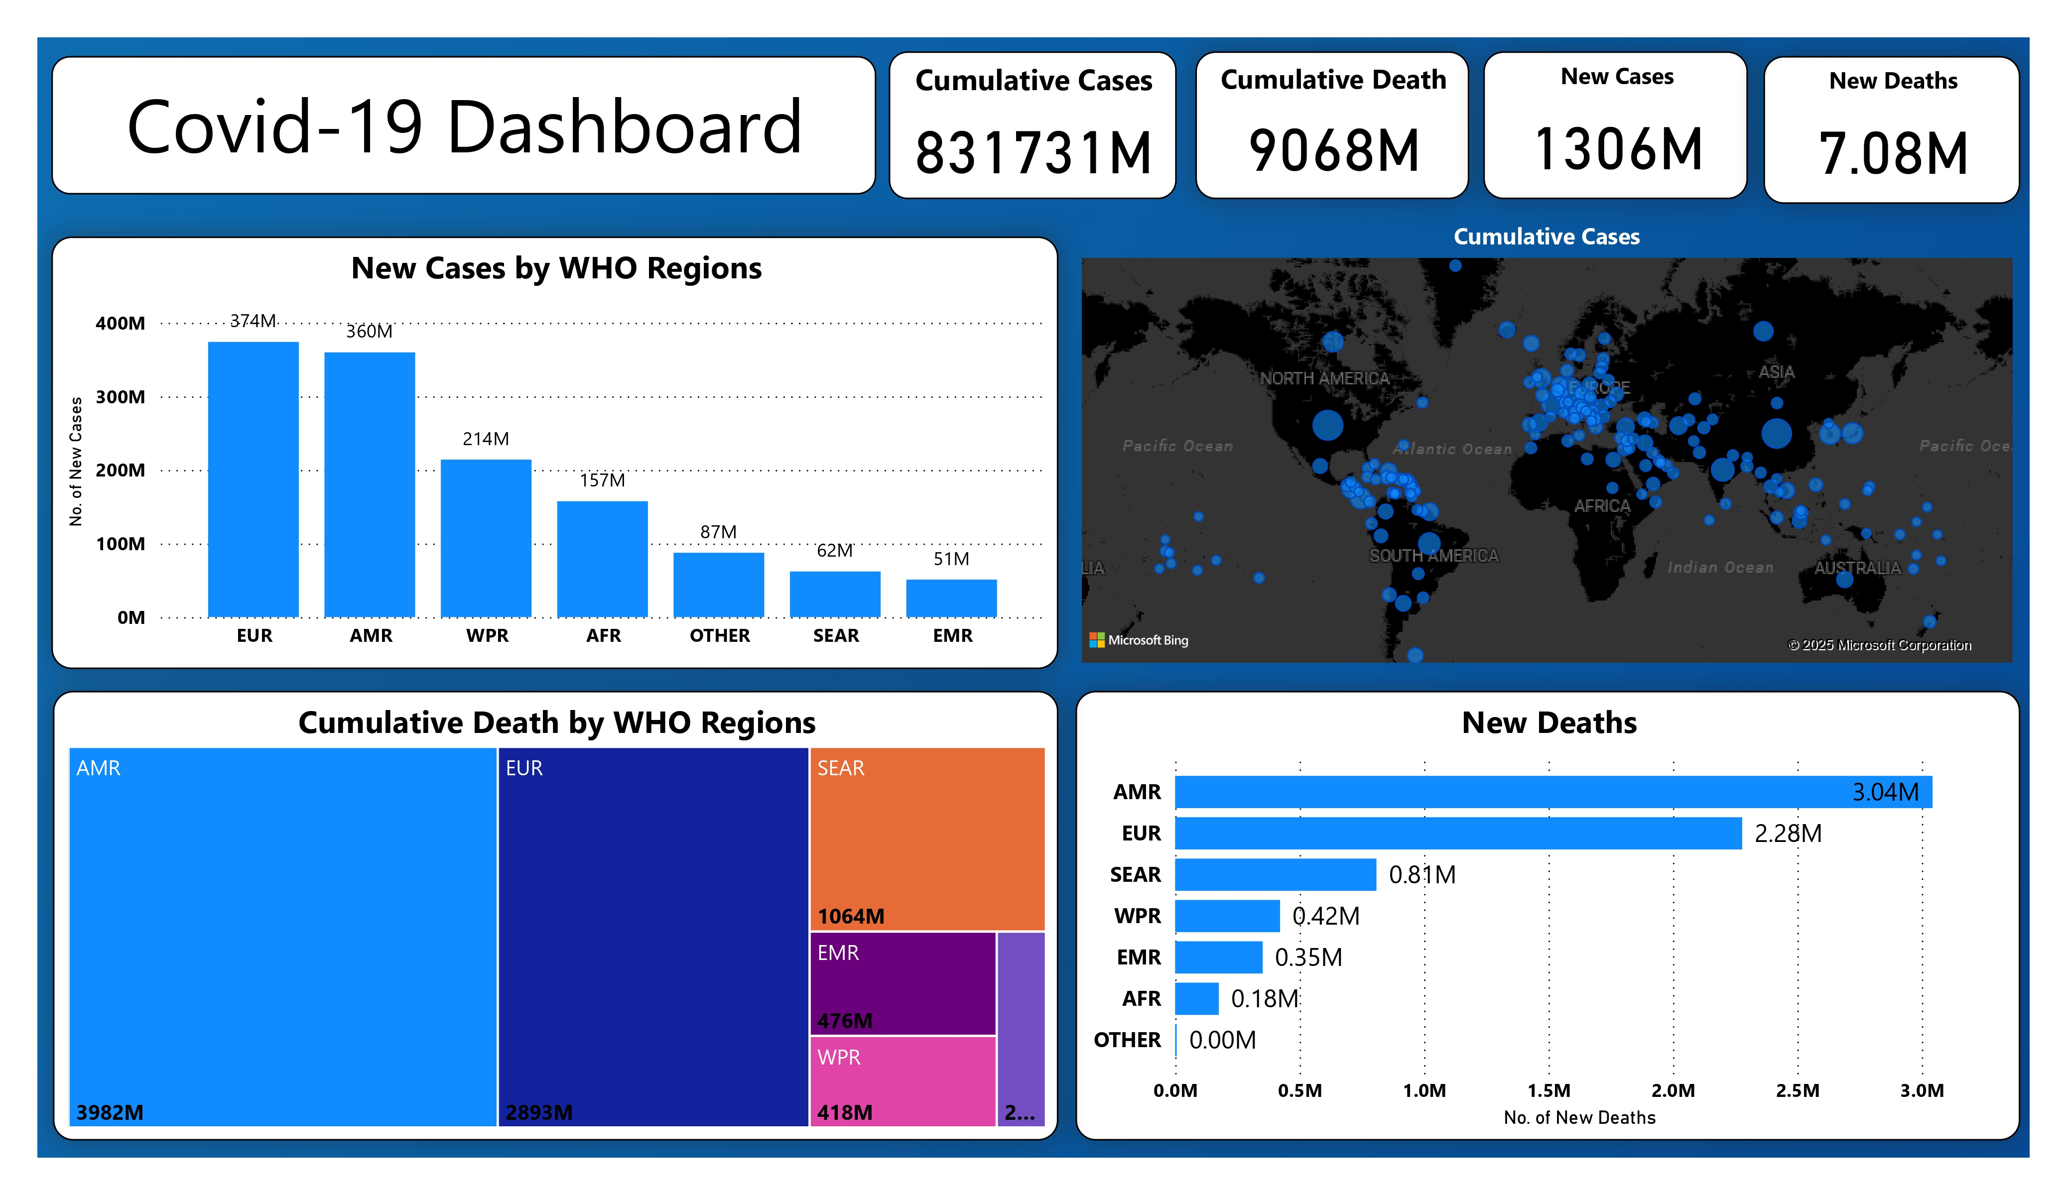
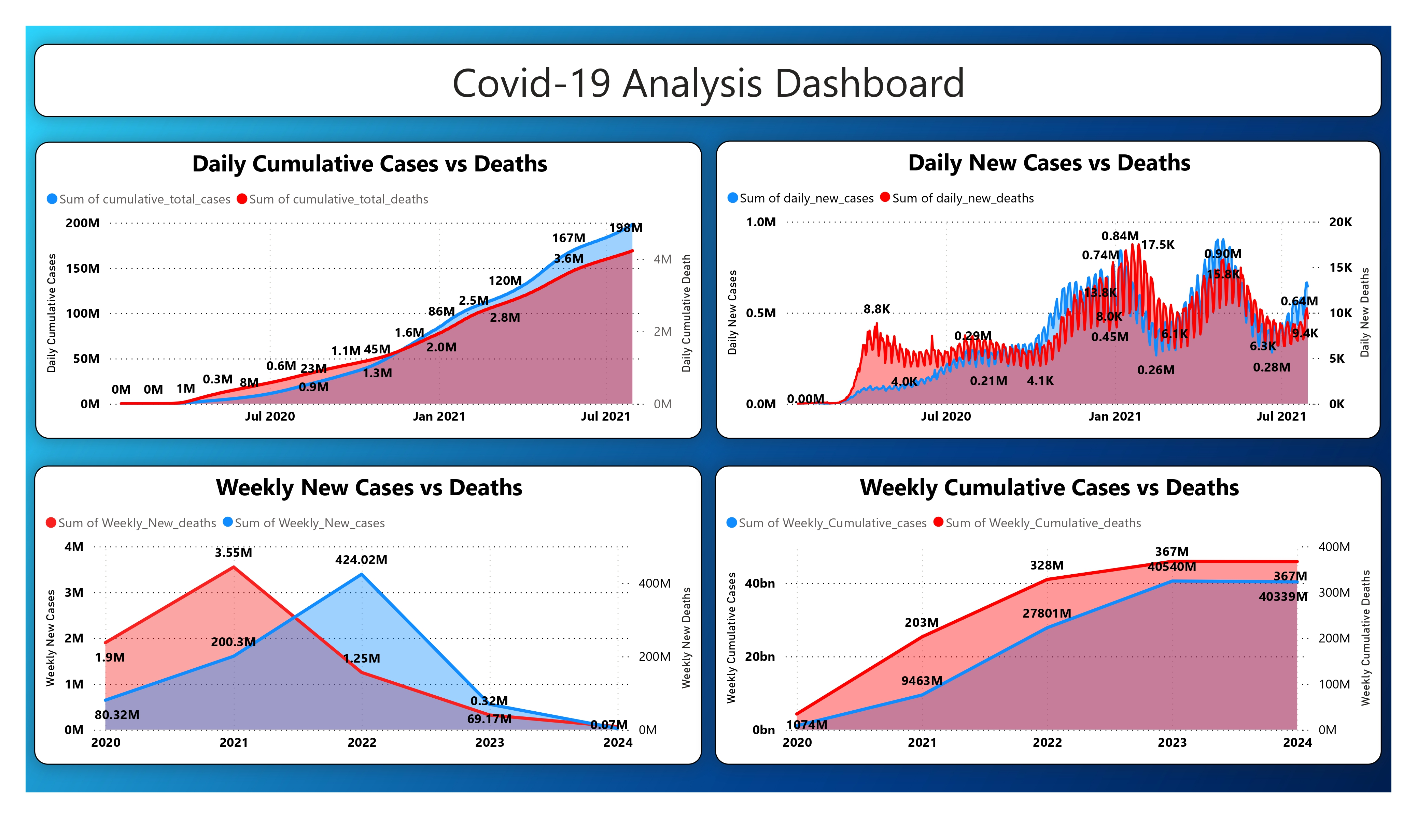
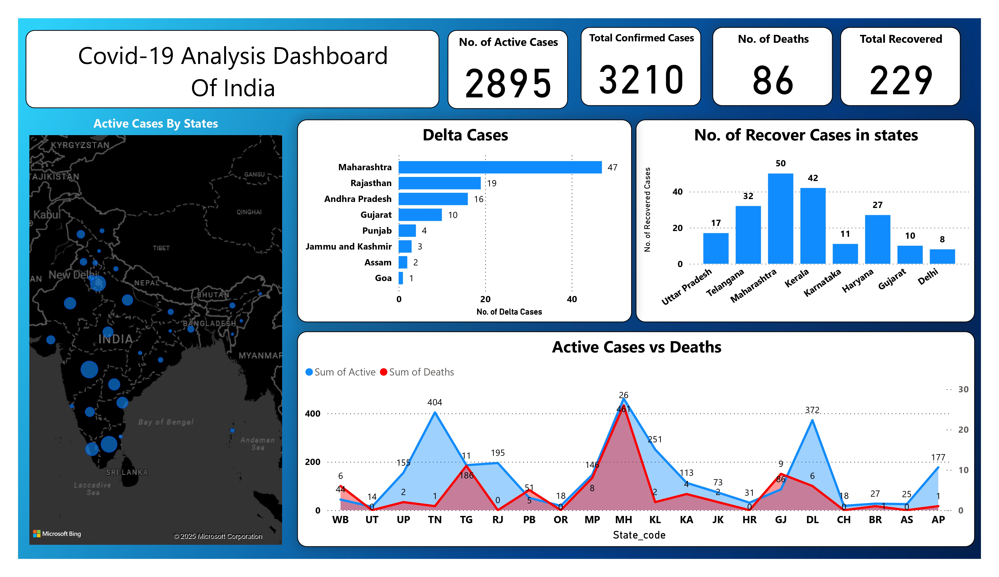
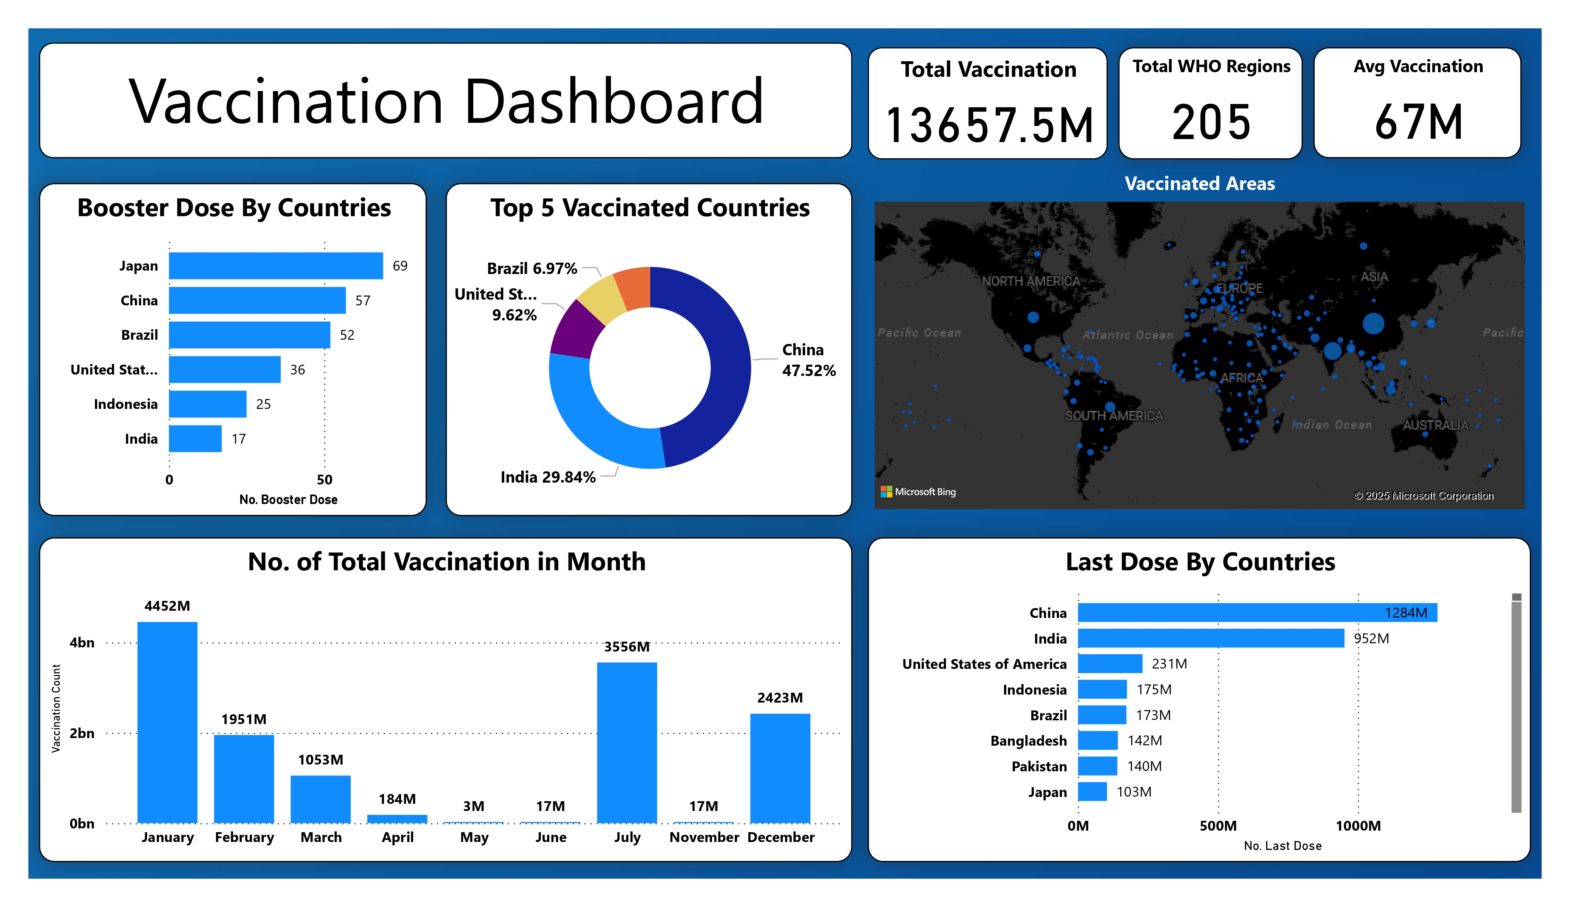
Result / Outcomes

Slide 10
Conclusion
Effective Data Visualization: Converts raw COVID-19 data into interactive and insightful visualizations.
Real-Time Monitoring: Provides up-to-date tracking of cases, deaths, and vaccinations.
Better Decision-Making: Helps policymakers and healthcare professionals implement data-driven strategies.
User-Friendly & Interactive: Enables easy navigation with dynamic filters, charts, and maps.
Risk Assessment & Resource Allocation: Identifies high-risk areas to optimize healthcare responses.
Future Readiness: Highlights the role of technology in managing global health crises effectively.

Slide 11
Future Perspective
Integration with AI & Machine Learning: Enhance predictive analytics for forecasting future outbreaks and trends.
Automated Data Updates: Implement real-time data syncing for more accurate and up-to-date insights.
Expanded Scope: Adapt the dashboard for monitoring other infectious diseases and public health crises.
User-Centric Enhancements: Improve accessibility with mobile-friendly and cloud-based solutions.
Global Collaboration: Facilitate data sharing among international health organizations for better pandemic management.
Advanced Risk Prediction: Utilize data science techniques to assess potential hotspots and prepare preventive measures.

Slide 12
Thank you...!
Notes:
12

